Slide 1
Preparation of Financial Statements - Accounting Principles
2022. 3.
Dr. Yangin Yoon

Slide 2
Recap the last class
Format of Accounting Records rule #1
- Asset (Left)
- Liability (Right)
- Equity (Right)
Income Statement
- Expense (Left) - Cash / Asset (Right)
- Cash / Asset (Left) - Revenue (Right)
Balance sheet

Slide 3
Cash Accounting vs. Accrual Accounting
ST Consulting borrowed $10,000 with 5% annual interest rate from a Bank on Oct. 1st, 2021.
- The borrowing period is one year.
- The principal ($10,000) and its interest ($500) will be paid on Sep. 30th, 2022 by cash.
What is the interest expense during the year 2021?
Option #1) Zero
Option #2) $500 * 3 / 12 = $125
Option #3) $500

Slide 4
Cash Accounting vs. Accrual Accounting
ST Consulting rented a shop with $10,000 of deposit and $500 of monthly fee for two years from Dec. 1st, 2021 to Nov. 30th , 2023.
- ST Consulting paid $10,000 of cash as deposit on Dec. 1st, 2021.
- And ST Consulting also paid $1,500 of cash for its three-month rent fee in advance as cash on Dec. 1st, 2021.
Accounting Records on Dec. 1st, 2021?
Accounting Records on Dec. 31st, 2021?
Dec.1., 2021
Deposit $10,000
Cash $10,000
Dec.1., 2021
Pre-paid Rent Fee $1,500
Cash $1,500
Dec.31., 2021
Rent Expense $500
Pre-paid Rent Fee $500

Slide 5
Accounting Official Terms
Journal Entry (General Journal Entry)
- Left Item: Debit
- Right Item: Credit
Example of Journal Entry
(Dr) Cash $2,000
(Cr) Bank Loan $2,000

Slide 6
Accounting Official Terms
Adjusting Entries
- Reflecting accrual accounting
- Examples:
Dec.31., 2021
Interest Expense $125
Unpaid Interest Expense $125
Dec.31., 2021
Rent Expense $500
Pre-paid Rent Fee $500

Slide 7
Accounting Official Terms
Closing Entries
- Moving revenue accounts and expense accounts into one equity account
- After closing entries, there will be zero balance amounts in revenue and expense accounts
- Example:
Revenue (gain) $5,000
Salary Expense $2,000
Earnings $3,000

Slide 8
Accounting Official Terms
Trial Balance
- Aggregated all journal entries
Adjusted Trial Balance
- Trial Balance + Adjusting Entries
- Sometimes, people say trial balance, meaning “adjusted trial balance”, depending on the context

Slide 9
Accounting Official Terms
Journal Entry
Journal Entry
Adjusting Journal Entry
Closing Journal Entry

Slide 10
Any Questions? (Recap)

Slide 11
Financial Statements
Financial statements:
https://dart.fss.or.kr/
https://www.google.com/
Annual report:
- Korean companies
- BMW
- Microsoft
- Netflix

Slide 12
Financial Statements
Financial statements:
https://dart.fss.or.kr/
https://www.google.com/
You can find the financial statements:
- Do it yourself, pick one company, and find its financial statements
- Financial Statements, Annual Report, or Audit Report

Slide 13
Financial Statements
Financial Statements:
- Statement of Financial Position
- Statement of Comprehensive Income
- Statement of Changes in Equity
- Statement of Cash Flows
- Notes

Slide 14
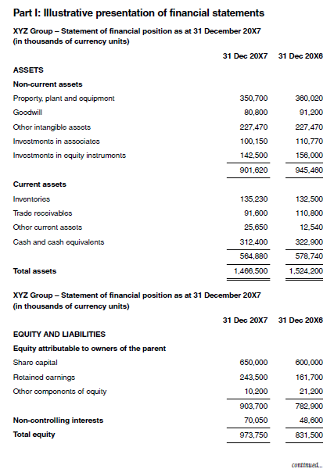
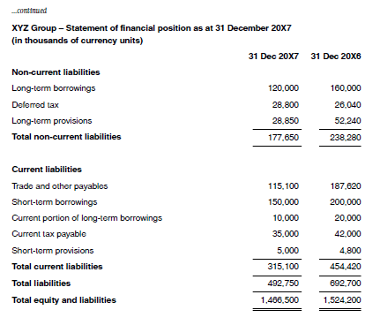
Financial Statements
Financial Statements:
- Statement of Financial Position

Slide 15
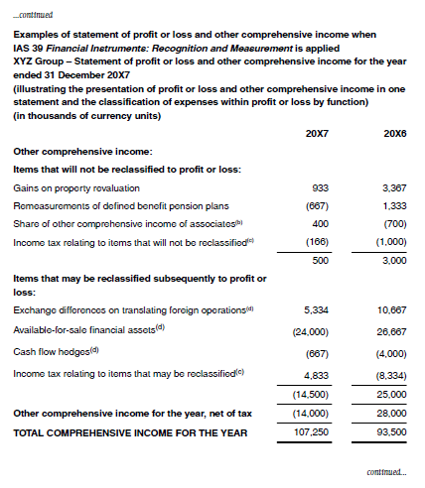
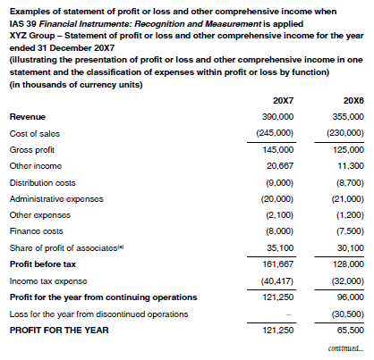
Financial Statements
Financial Statements:
- Statement of Comprehensive Income

Slide 16
Financial Statements
Rules:
- Natural law
- Man-made rules (laws?)
Accounting rules (GAAP, Generally Accepted Accounting Principles)
- IFRS, K-IFRS, K-GAAP, etc.
- Let’s find some:
https://www.google.com/
(http://www.kasb.or.kr/fe/accstd/NR_list.do?sortCd=K-IFRS&divCd=01)
(https://www.ifrs.org/issued-standards/list-of-standards/)

Slide 17
Financial Statements
Interconnection among financial statements
- Income Statement and Statement of Financial Position
- Statement of Financial Position and Statement of Changes in Equity

Slide 18
Any Questions?

